Slide 1

The Problem: Colorado Water Right Clarity
My Colorado WATER Portal
PRESENTED BY:
KEVIN BUECHER & SCOTT WILLIAMS & MATT RIDDOCH

Slide 2
Top 10 Question about Colorado Water Rights
What is my water worth?
How do I contact my ditch company/ ditch rider/ district commissioner?
What is the name of the structure near, behind, or through my property?
How do I purchase water rights?
How do I sell my water rights?
How do I lease my water rights?
Can I lease my groundwater out of my drainage basin by water truck?
How do I purchase an augmentation plan?
Can I purchase water rights to hold as an investment like stocks or bonds?
When will my ditch start running water for the current irrigation season and what’s my allocation amount?

Slide 3
Who is Inquiring & What About 2016?
Total inquiries looking for current market values: 131
Total inquiries looking to purchase: 60
Total inquiries looking to sell: 58
Total inquiries looking for contact info: 35
Total inquiries looking to lease: 20
Total inquires in 2016: 394
Total market value of sample set water data brokered in 2016: $787,300.00

Slide 4
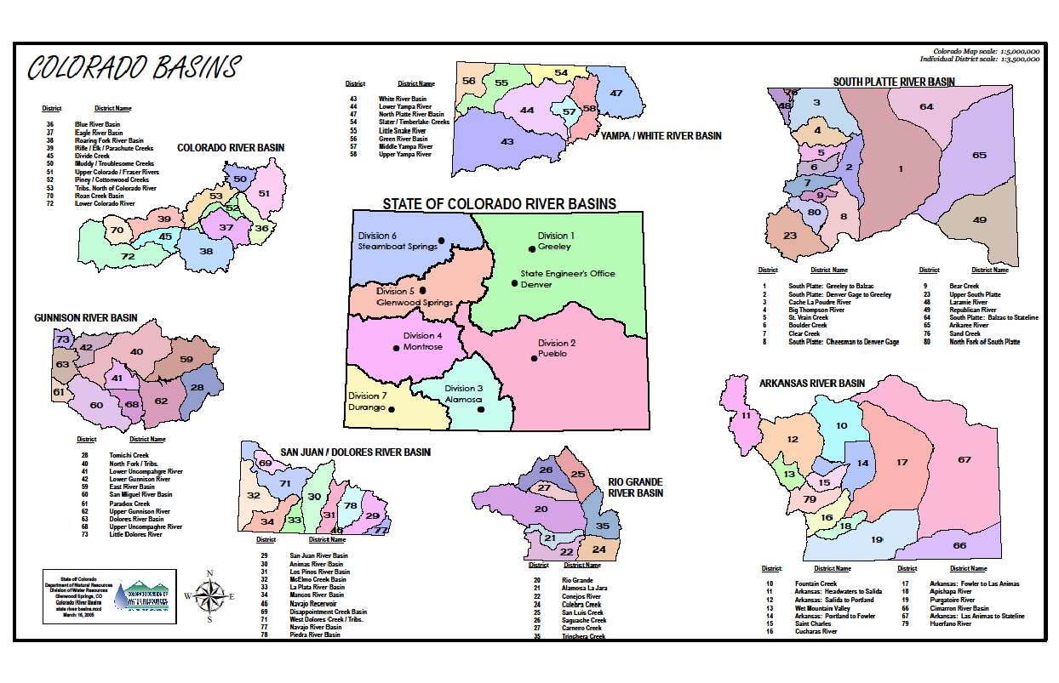
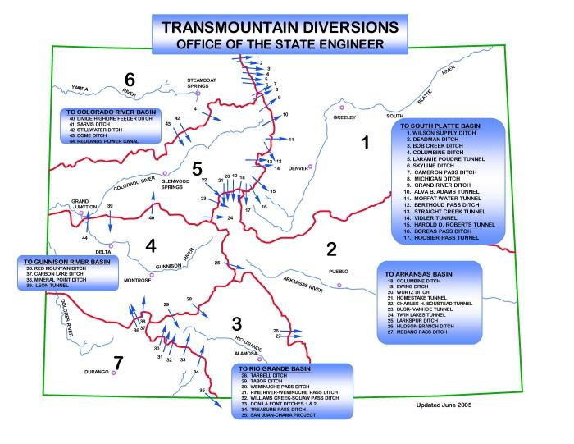
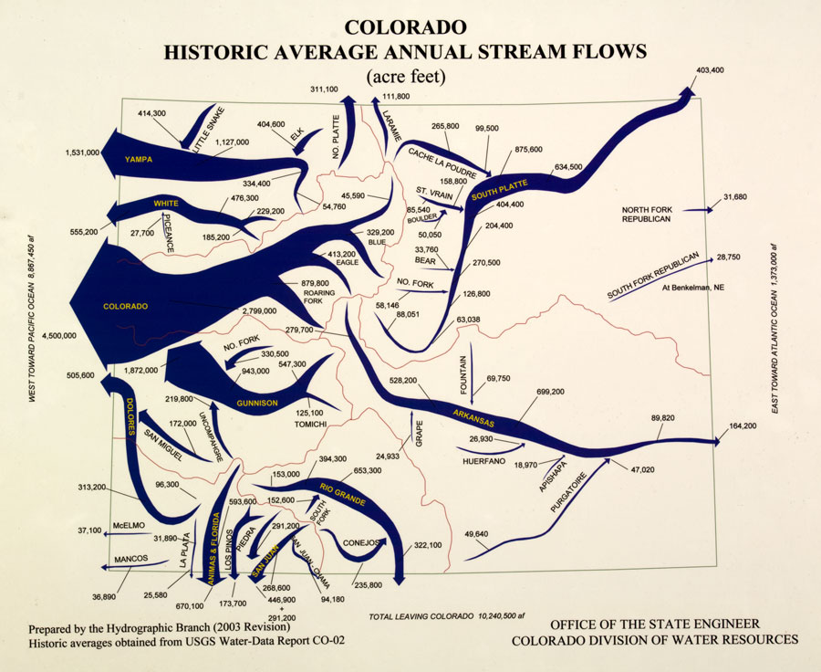
Current State of Colorado Water Right Portals and Water Law

Slide 5
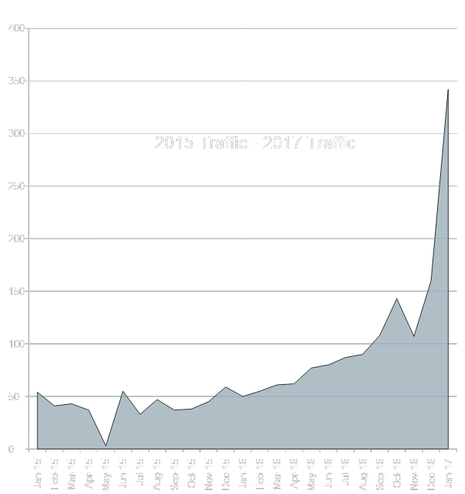
How Politics & Presidential Elections Can Influence Water Markets
113.75% Increase in Web Traffic Between Dec. 2016 & Jan. 2017
342 New IP address views Jan. 2017

Slide 6
Real-Estate Outlook
22,800 Active Canals and Ditches in Colorado
40,000+ Water Right Holders
$3 billion Colorado Land and water market within the $300 Billion State wide Real Estate Market
Colorado’s business fillings have 638 possible tax combinations.
Only accessible to those with the knowledge or financing available to use expensive mapping technologies to access the market. The
Pain of discovering the price of water and land is hard to gather and even more difficult to understand.

Slide 7

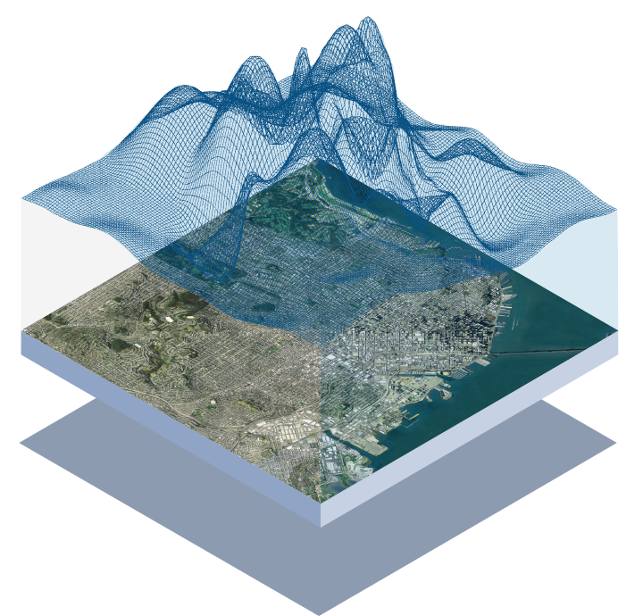
Drone Mapping & Data Acquisition
Drone Mapping and Date acquisition has become affordable, faster, and more accurate than humans.
Even in this emerging market there is opportunity for growth in developing mapping programs that analysis data in real time in various layers.
Resulting in the most detailed interactive mapping software for Colorado Water Rights.

Slide 8
Problems only Get BIGGER!
Deeper RESEARCH
People Continue to ask Colorado Water Right Clarity Questions due to Water only becoming more of a hot topic.
After vetting multiple sources some times costly, are left feeling answers are hidden behind closed doors & complex search sites.
Due to complexity of search and inconsistency of results people are required to vet multiple results .
Multiple Portal Searches
More questions than Answers

Slide 9
Interested in Tackling the Problem?
My Colorado Water Portal is seeking $500,000 in equity and start-up funds for:
Finance data acquisition and client lists
Website and search portal build out & coding
Establish office locations in all 7 water Divisions
Finance Drone Arial mapping and pilot training
Create new and exclusive Colorado Water Rights research & mapping tools
Finance Initial Product launch to Colorado Water Right Holders
Hire new team members and retain expert water consultants in various disciplines of : Civil Engineering, Law, and SEO to name a few.

Slide 10
Thank you for inviting us to shed light on the Problem: Colorado Water Right Clarity
My Colorado WATER Portal
QUESTIONS?

